Slide 1
SEP Events Testing
Aug 2019
Martin Kerr

Slide 2
Who we tested with
15 Online un-moderated test sessions, with Userzoom panel, for usability testing
30 Userzoom panel members were used for a survey question on: listings, summaries and when to send them to a providers site

Slide 3
SEP Events Summary
The filters worked quite well
The map works very well for some people and not so well for others. It is largely a matter of personal preferences around visualisation of content.
People expect to be able to use both/either Post Code or Town/City name to locate events
The number of options available changed between pages and this confused customers
Support type was not used at all but was not needed to complete any of our test scenarios
The general feel was that the proposed filters and map view worked more than well enough to be put into production

Slide 4
What we were trying to find out
We had a very rough SEP prototype to test. It was intended to allow us to test Events functionality.
We were interested in:
Did people notice the number of support options and events listed
Did the filters work (in the broadest possible sense)
Did people notice the number of options falling when they filtered
Could people find support for finding a new employee
Could people date filter Events
Could people find local Events
How well would the Map view work
Could they zoom in on Glasgow and ultimately find the details of an Event at the Hydro.
We also asked a survey question: Would people expect to see a summary of support before being referred off to a providers website?

Slide 5
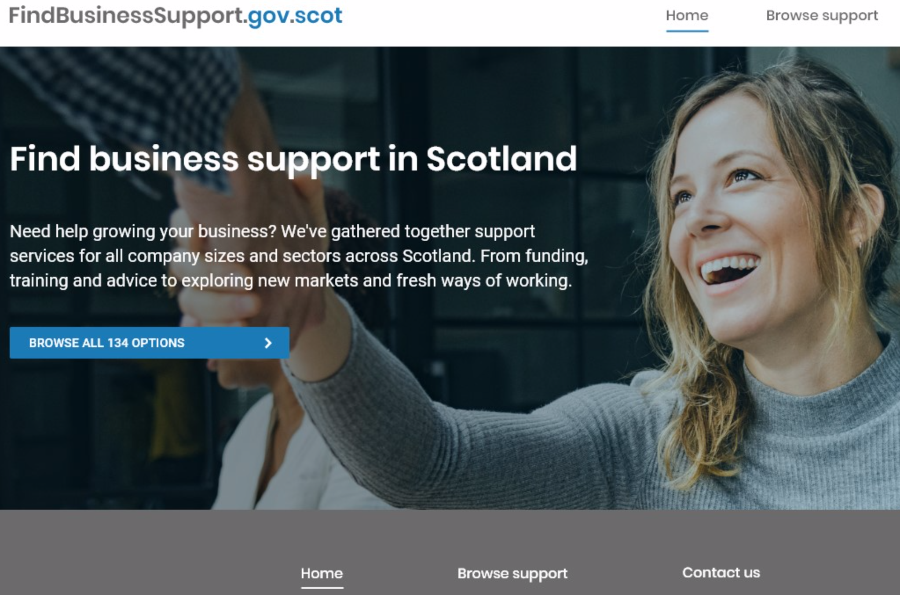
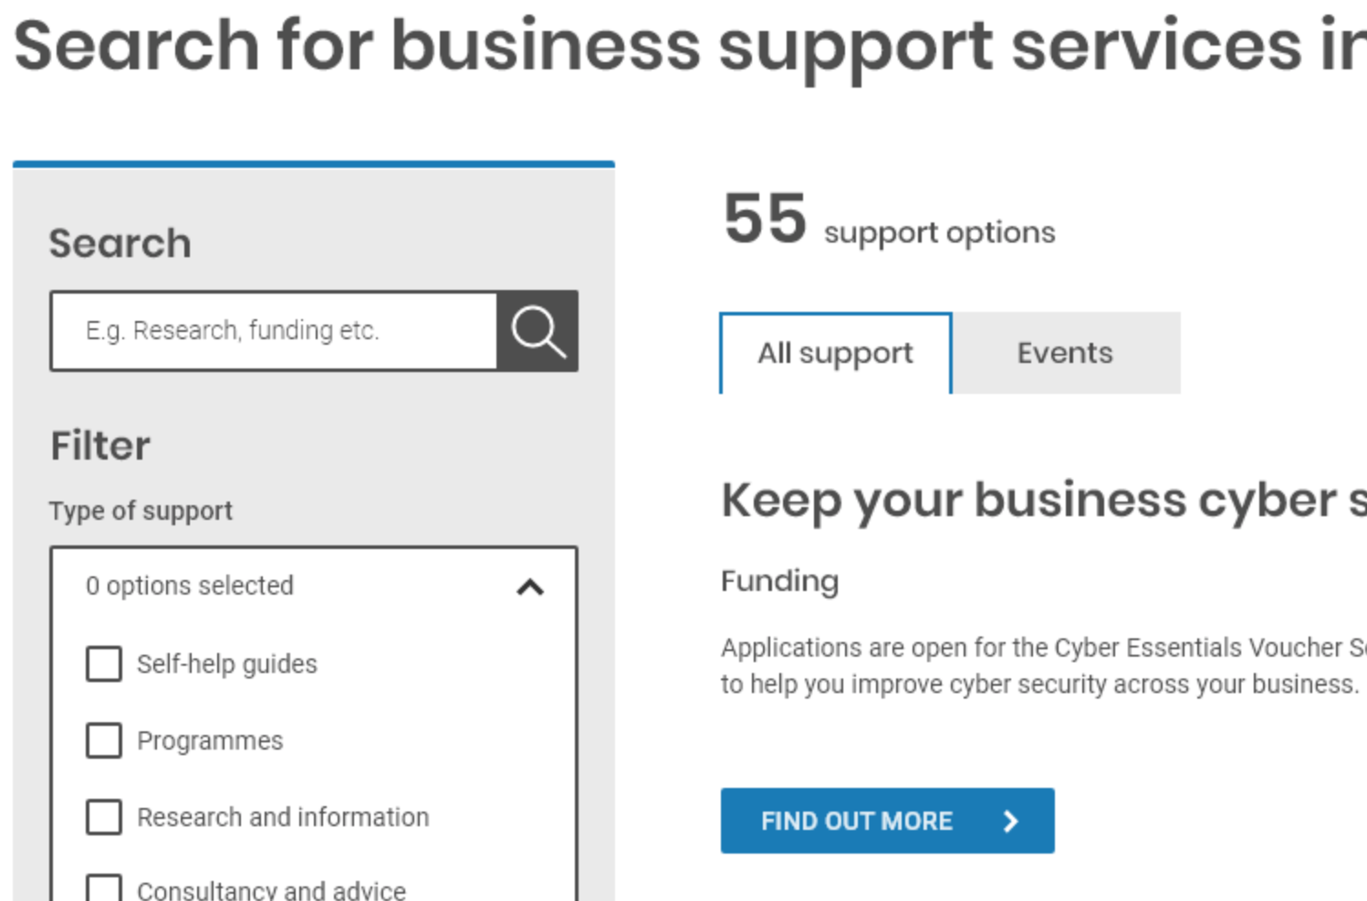
Number of support options
People noticed the number IF they used the Blue Button
A few people got quite confused by the number changing when they clicked through to the support listing
(55 support options + 79 Events = 134 number quoted on the home page)
Recommend dropping the number from the home page

Slide 6
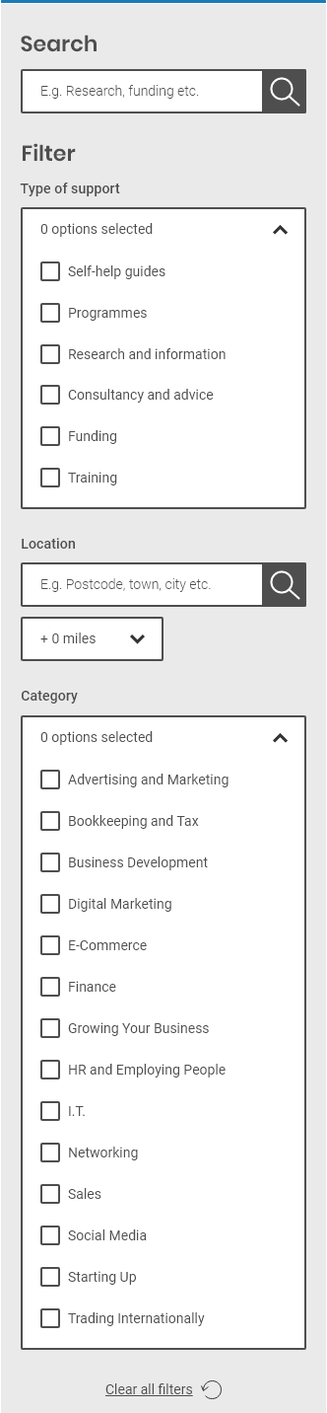
Filters
Filters were fairly well received
Search was used a lot. Some people even put Postcode and Town names into the search box Around 2 thirds of people used Post Code
Around a half of people used Town or City
(Some people obviously tried both)
Mileage range suggestions ranged from 1 to 50 miles
Recommend: Have a broad range of mileage options with granular differences lower down in the range
The categories were used well but there were some suggestions for additions

Slide 7
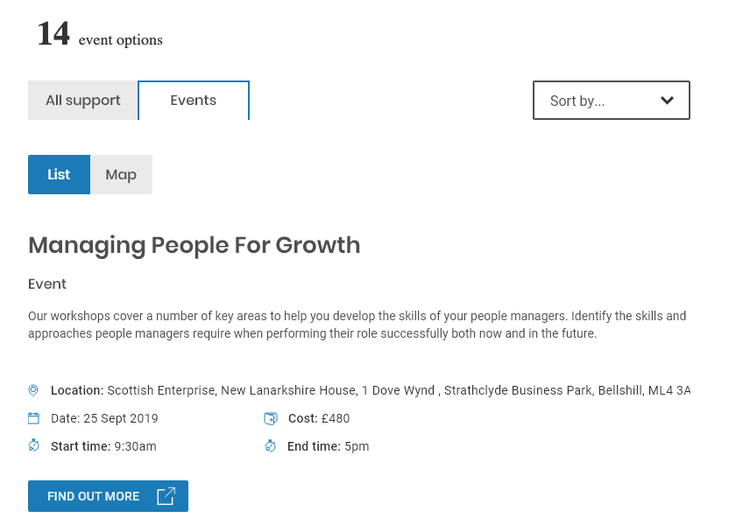
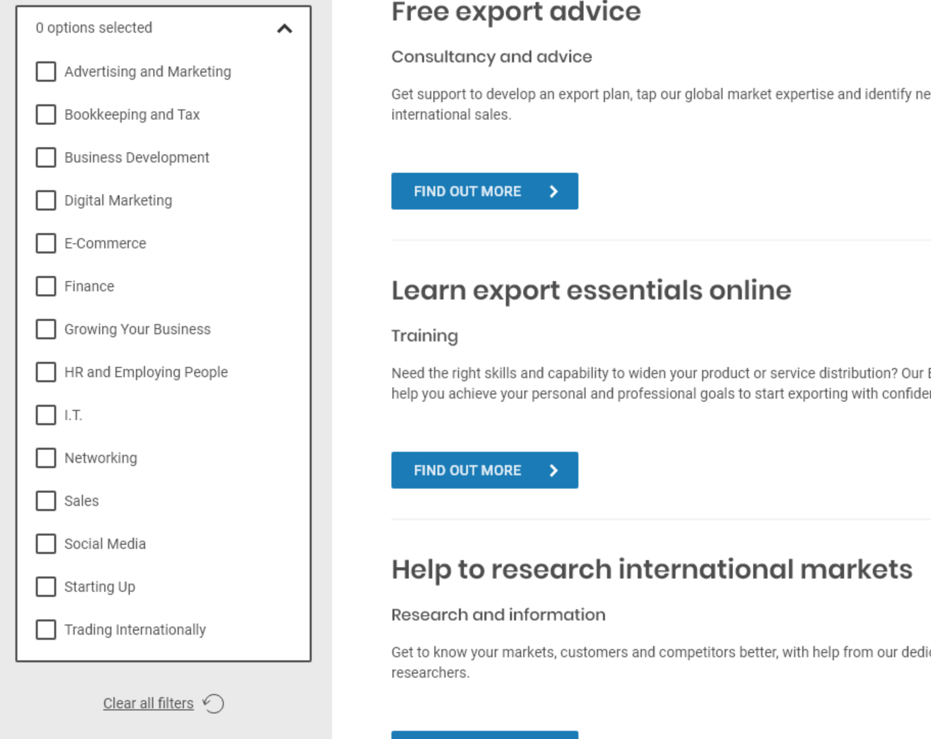
Support numbers dropping when filtered
Most people noticed that the number was dropping when they filtered.
The event metadata (Location, Date, Cost, Time) was easily discovered and well received.
The number dropping on filtering, was less obvious when they had scrolled down to use filters bellow the fold.
Observation: The page does not auto-scroll back to the top when filtering

Slide 8
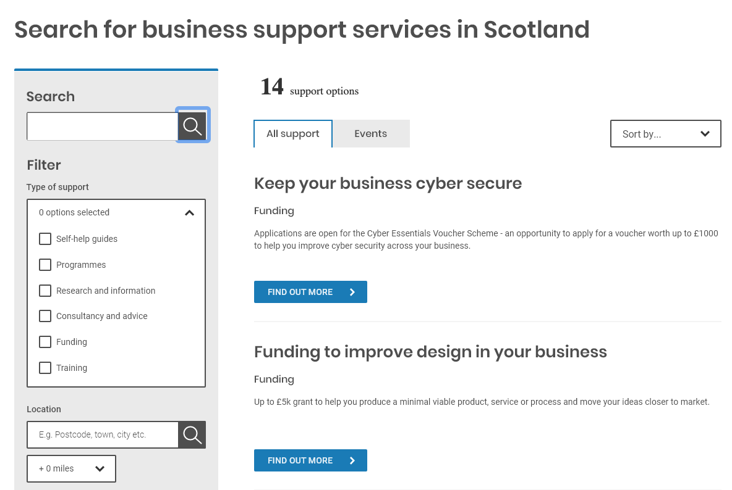
Find support for a new employee
Most people used the category filter (HR & Employing people)
The headings worked well as they were clear and very easy to scan
Search was also used by most
Users did succesfully find support for taking on a new employee

Slide 9
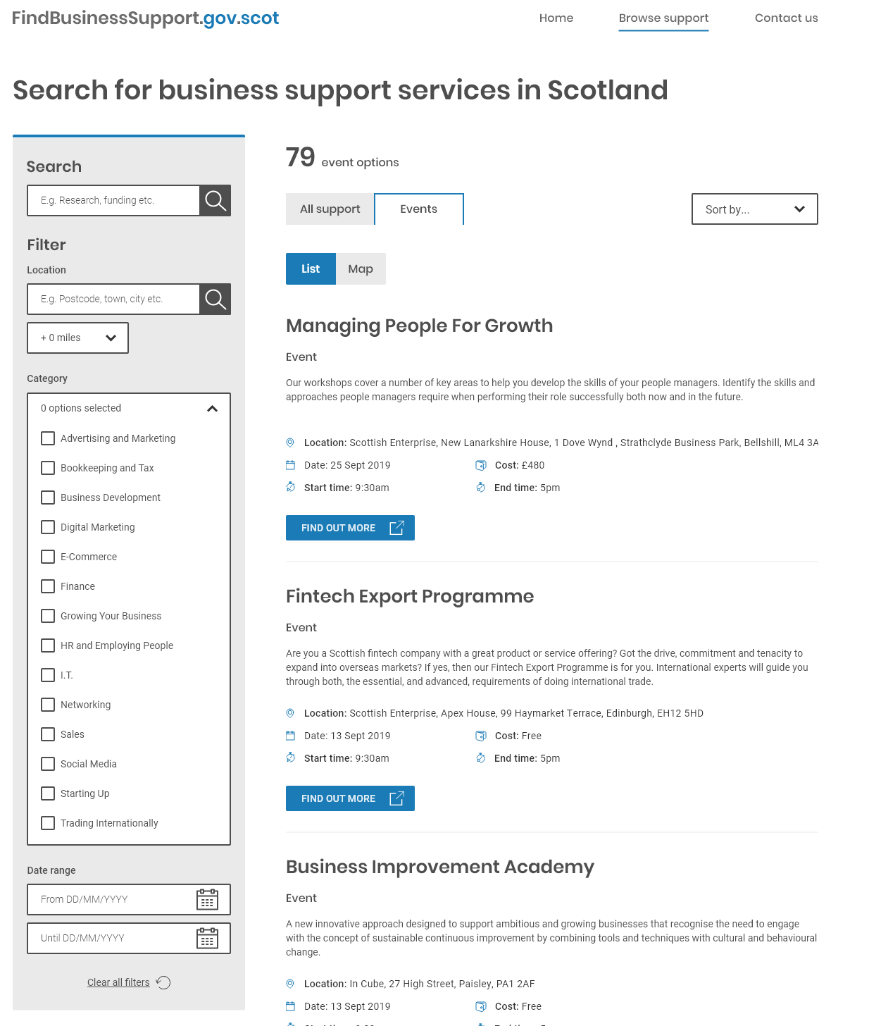
Date filter events
A few people actually used the “Sort By” option to date sort the results.
Most people had no problem with the date pickers when they found them.
The date filters were less obvious than the others.

Slide 10
Find local events
Some people put Postcode and Town names into the search box
Most people put a postcode or town/city name in the “Location” box.
Desired mileage limits were large in rural areas and smaller in the central belt
Ranges were from 1 to 50 miles

Slide 11
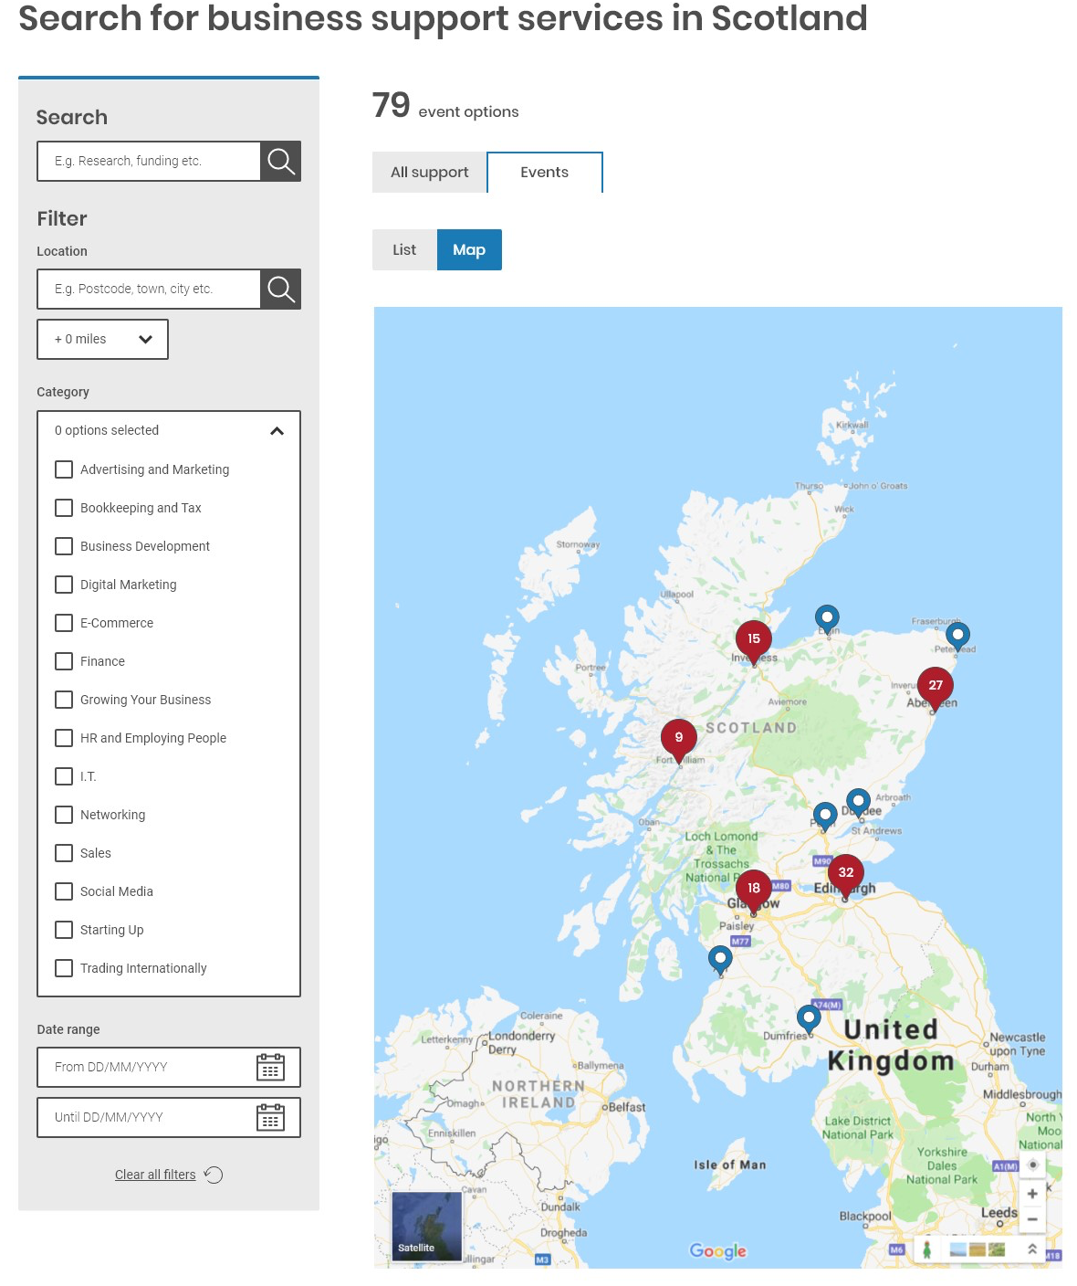
Map view
The map view worked quite well
They noticed the number of events
People jumped back and forwards between the filters and the map, and expected the map to have been updated
They noticed the List/Map control
BUT
Not everyone could point to Glasgow on a map.
Observation: this will work well for some people and not so well for others.

Slide 12
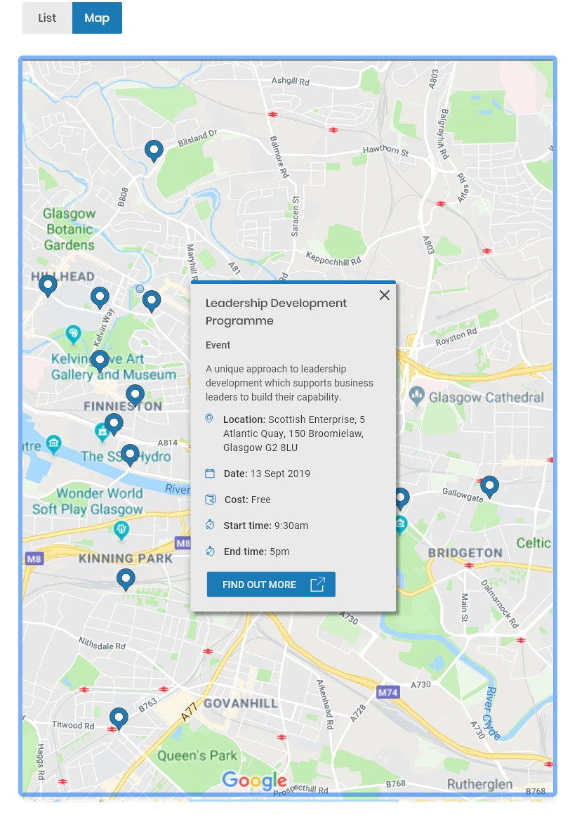
Glasgow Hydro event
People who new where the Hydro was, had no problems finding the event and clicking on it to see details.
Others failed on this task.
Observation: this will work well for some people and not so well for others.
The event details were well received and found to be clear and concise

Slide 13
Summary first or jump straight to provider
We asked 30 people if they would prefer to jump straight from the listings to a providers website or see a summary of the Event/Support first.
28 of 30 respondents said they would like to see a summary first.
This question was quite blunt and would benefit from some more detailed research around customer attitudes and expectations

